Slide 1


Denis Wave
2024.12.11.

Slide 2

Outline
Executive Summary
Introduction
Methodology
Results
Conclusion
Appendix

Slide 3
Executive Summary
Summary of methodologies
Data Collection through Web Scraping
Machine learning models were built
Data Visualisation with Python
Summary of all results
Optimal model for Predictive analysis
Data Visualisation for decision making

Slide 4
Introduction
Project background and context
The commercial space industry has entered an era where space travel is becoming more accessible and affordable for the broader public. Various companies are now offering suborbital spaceflights, with SpaceX emerging as the most prominent player in this field.
SpaceX's notable achievements include:
Sending spacecraft to the International Space Station (ISS),
Deploying Starlink, a satellite constellation providing global internet coverage,
Conducting manned space missions.
One key factor behind SpaceX's success is the relatively low cost of its rocket launches.
Problems you want to find answers
The primary goal of this project is to estimate the cost of each SpaceX launch by analyzing the reusability and performance of its Falcon 9 rockets.

Slide 5

Section 1

Slide 6
Methodology
Executive Summary
Data collection methodology:
Data collected by Web Scraping
Perform data wrangling
Exploratory Data Analysis to find patterns and determine the training set
Perform exploratory data analysis (EDA) using visualization and SQL
Visualisation with with Pandas, Numpy and Seaborn libraries
Perform interactive visual analytics using Folium and Plotly Dash
Folium and Dash were used for Dynamic Data Visualisation
Perform predictive analysis using classification models
Create machine learnind pipline for prediction

Slide 7
Data Collection
Data were collected using the API call method from the SpaceX API, available at https://api.spacexdata.com/v4.
Pre-processing the data
Converting to a data frame using JSON
Filtering the data to keep only Falcon 9 launches
Collecting data with API calls
Converting the data to CSV

Slide 8
Data Collection – SpaceX API
1
Request rocket launch data from SpaceX API
2
Decode the response as JSON and convert it to a DataFrame
3
Pre-process the data and correct column names
4
Construct adataset using the obtained data

Slide 9
Data Collection - Scraping
1
Request the Falcon9 Lunch Wiki page
2
Extract all column names from the HTML header
3
Create a FataFrame by prasing the launch HTML tables

Slide 10
Data Wrangling
Calculate the number:
and occurence of each orbit
of lunches on each site
Create landing outcome label
and occurence of mission outcome per orbit type
Handling missing data

Slide 11
EDA with Data Visualization
Used graphs for the better understanding:
Scatter Plot
Bar Chart
Line Chart

Slide 12
EDA with SQL
Retrieve the names of unique launch sites used in space missions.
Display five records where the launch site names start with the string "CCA".
Calculate the total payload mass carried by boosters launched by NASA (CRS).
Find the average payload mass carried by the booster version "F9 v1.1".
Identify the date of the first successful ground pad landing.
List the names of boosters that successfully landed on a drone ship and carried payloads between 4000 and 6000 kilograms.
Provide the total count of successful and failed mission outcomes.
Identify the booster versions that carried the maximum payload mass.
List the failed drone ship landing outcomes along with the corresponding booster versions and launch site names.

Slide 13
Build an Interactive Map with Folium
Map objects summary:
Markers: Display a geographic location using latitude and longitude data.
Cluster: Represent a group of markers.
Circles: Highlight a single location on the map.
Lines: Indicate the distance or connection between two locations.

Slide 14
Build a Dashboard with Plotly Dash
Plot summary:
Bar Chart: Illustrates differences between categories.
Line Chart: Displays changes over time in a time series.
Pie Chart: Represents the percentage distribution of events.
Tree Map: Visualizes complex relationships between variables interactively.
Map: Depicts variables geographically, such as across different states.

Slide 15
1
Create a variable Y and standardize the variable assigned to X
2
Split in train and test database
3
Calculate logistic regression, decison tree and knn
4
Calculatethe number and occurence of mission outcome per orbit type
5
Compare score accurancy to chose the best model
Predictive Analysis (Classification)

Slide 16
Results
Exploratory data analysis results
Web scraping is capable of collecting SpaceX Data
Interactive analytics demo in screenshots
Data analysis with SQL is effective for filtering data.
Data analysis with interactive visualization provides insights.
Plotly Dash is powerful for displaying data changes.
Predictive analysis results
The Decision Tree Classifier algorithm has good accuracy for prediction.

Slide 17

Section 2

Slide 18
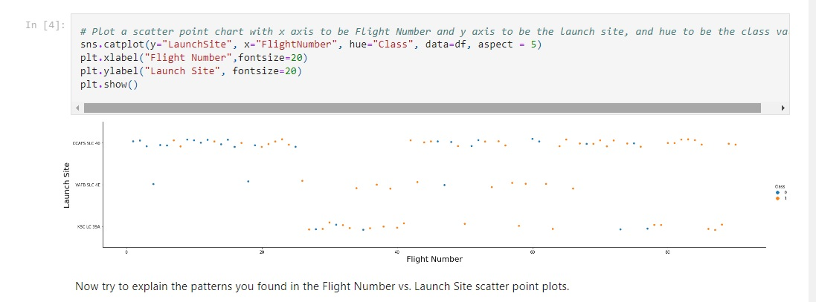
Flight Number vs. Launch Site
Show a scatter plot of Flight Number vs. Launch Site
For the CCFS SLC40 category, there seems to be a higher concentration of flights with a high number compared to class 1
GitHub link: https://github.com/hullamd/DSCapstone

Slide 19
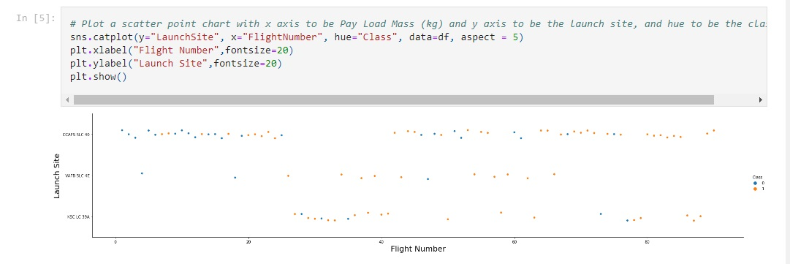
Payload vs. Launch Site
In this case, there does not appear to be a strong correlation
GitHub link: https://github.com/hullamd/DSCapstone

Slide 20
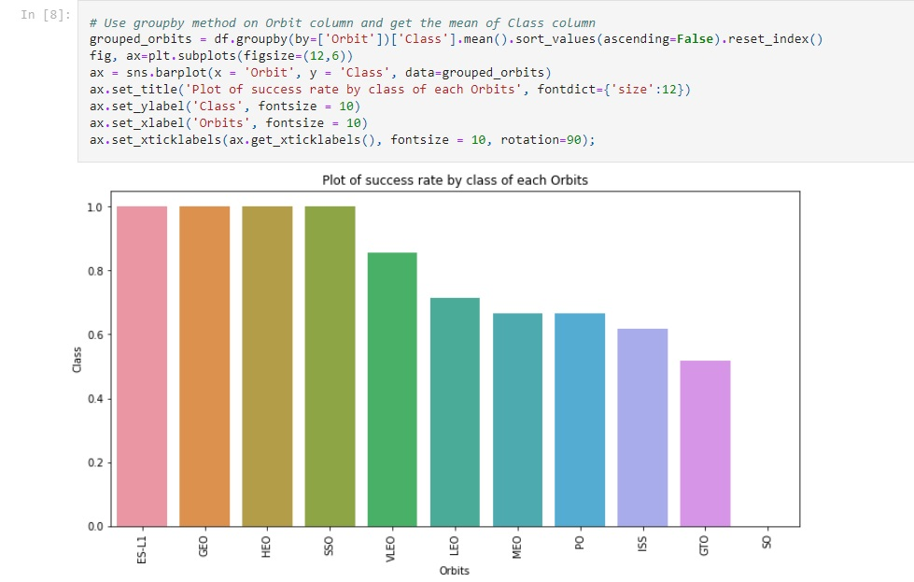
Success Rate vs. Orbit Type
We can see that the orbits with the highest success rates are SSO, HEO, GEO, and ES-L1, while the GTO orbit has the lowest success rate.
GitHub link: https://github.com/hullamd/DSCapstone

Slide 21
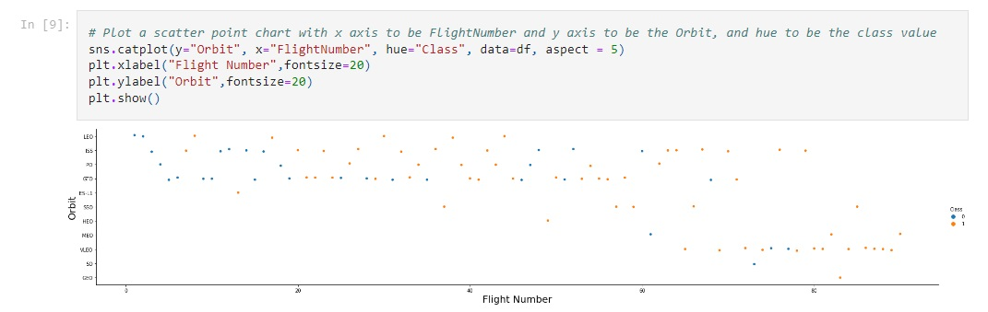
Flight Number vs. Orbit Type
In the LEO orbit, success appears to be related to the number of flights. On the other hand, there seems to be no relationship between the number of flights and success in the GTO orbit
GitHub link: https://github.com/hullamd/DSCapstone

Slide 22
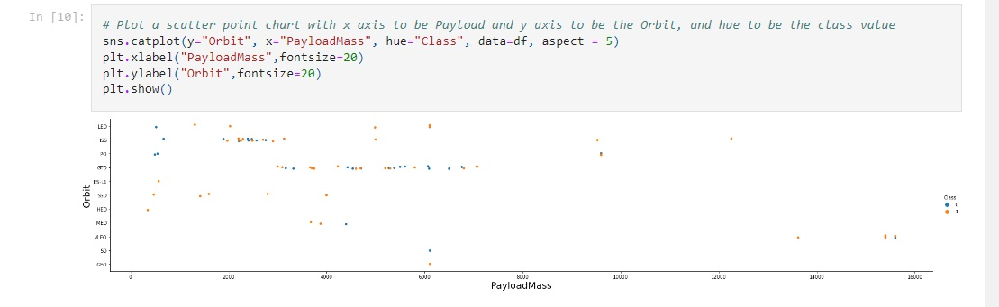
Payload vs. Orbit Type
Heavy payloads have a negative influence on GTO orbits and a positive influence on GTO and Polar LEO orbits
GitHub link: https://github.com/hullamd/DSCapstone

Slide 23
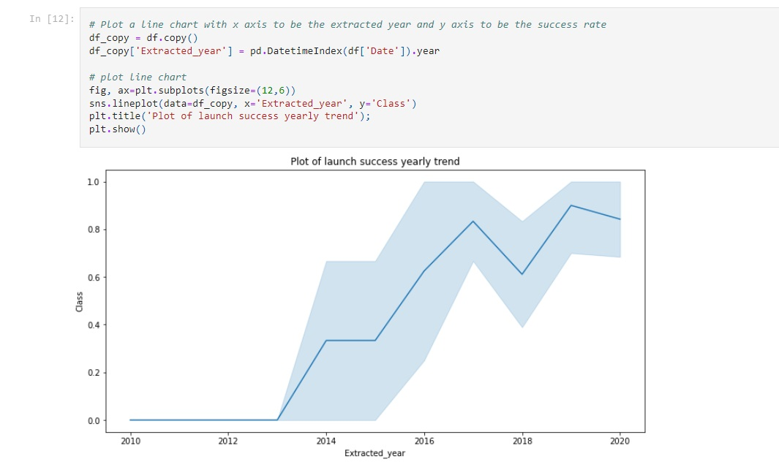
Launch Success Yearly Trend
The success rate is increasing since 2013
GitHub link: https://github.com/hullamd/DSCapstone

Slide 24
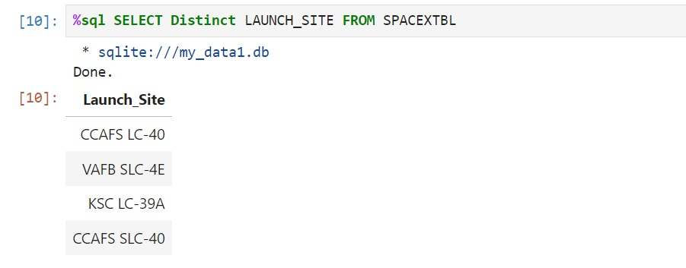
All Launch Site Names
4 sites are presented in the database.
GitHub link: https://github.com/hullamd/DSCapstone

Slide 25
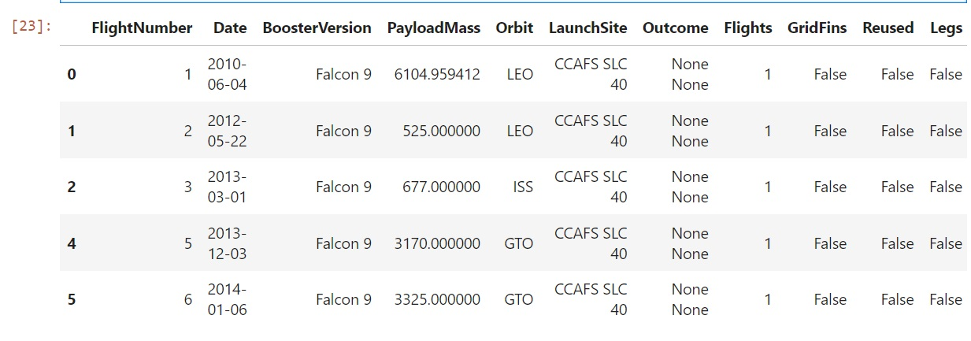
Launch Site Names Begin with 'CCA'
Find 5 records where launch sites begin with `CCA`
Present your query result with a short explanation here
GitHub link: https://github.com/hullamd/DSCapstone

Slide 26
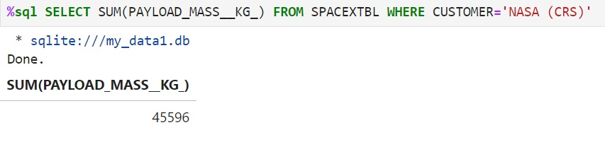
Total Payload Mass
We can get the sum of all values by using the ‚SUM’ function,
GitHub link: https://github.com/hullamd/DSCapstone

Slide 27
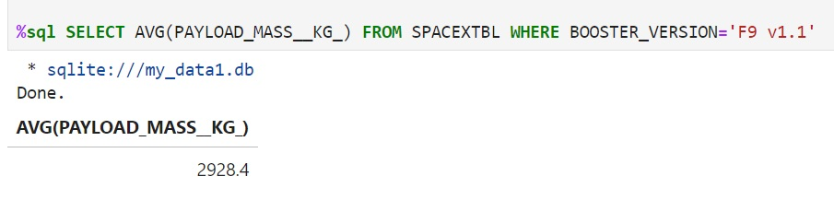
Average Payload Mass by F9 v1.1
We van get the average of all values by using ‚AVG’ function.
GitHub link: https://github.com/hullamd/DSCapstone

Slide 28
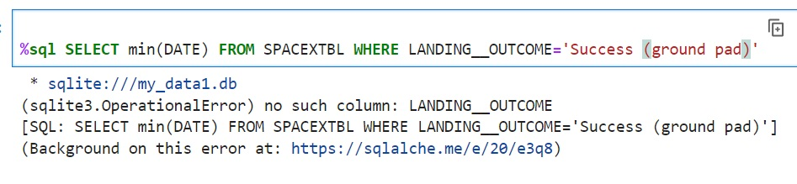
First Successful Ground Landing Date
We can get the first succesful data by using the ‚MIN’ function.
GitHub link: https://github.com/hullamd/DSCapstone

Slide 29
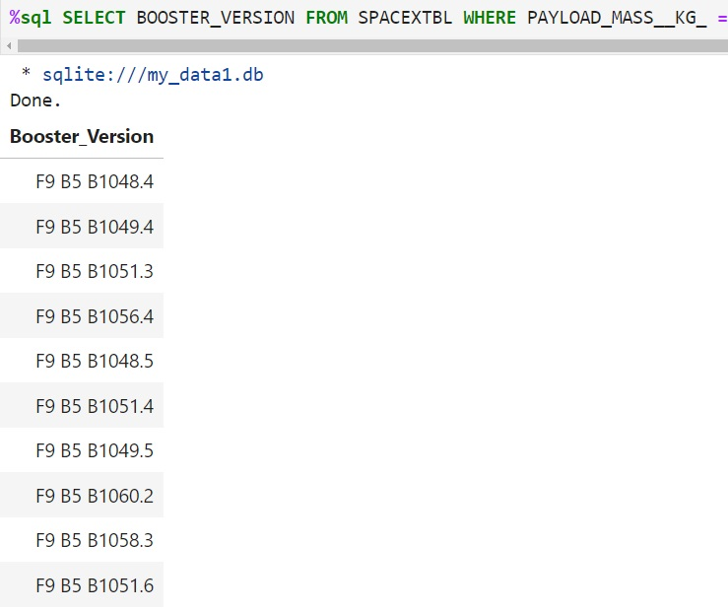
Successful Drone Ship Landing with Payload between 4000 and 6000
GitHub link: https://github.com/hullamd/DSCapstone

Slide 30
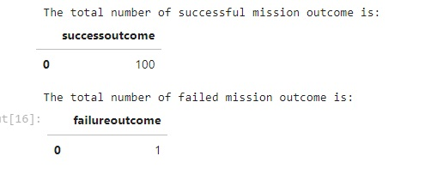
Total Number of Successful and Failure Mission Outcomes
We can get the number of all successful and failure missions by using COUNT and LIKE functions
GitHub link: https://github.com/hullamd/DSCapstone

Slide 31
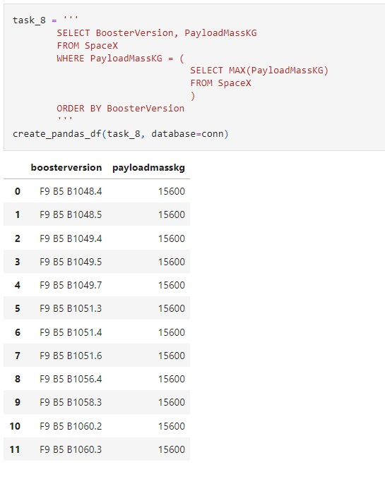
Boosters Carried Maximum Payload
We can get the max playload masses by using MAX function.
GitHub link: https://github.com/hullamd/DSCapstone

Slide 32
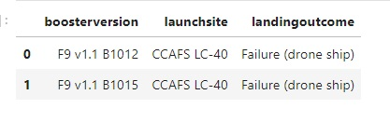
2015 Launch Records
We can get the months using month(DATEW) and WHERE functions.
GitHub link: https://github.com/hullamd/DSCapstone

Slide 33
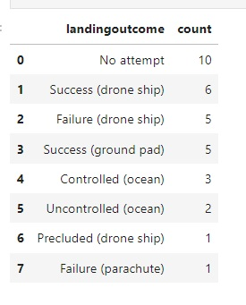
Rank Landing Outcomes Between 2010-06-04 and 2017-03-20
GitHub link: https://github.com/hullamd/DSCapstone

Slide 34

Section 3

Slide 35
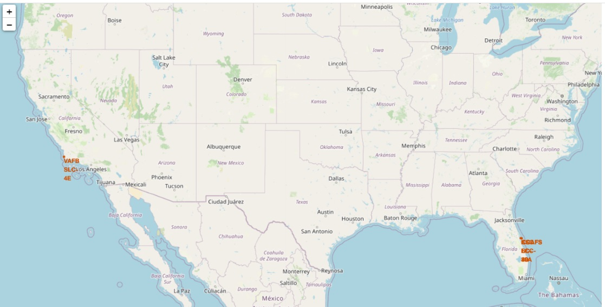
<Folium Map Screenshot 1>
GitHub link: https://github.com/hullamd/DSCapstone

Slide 36
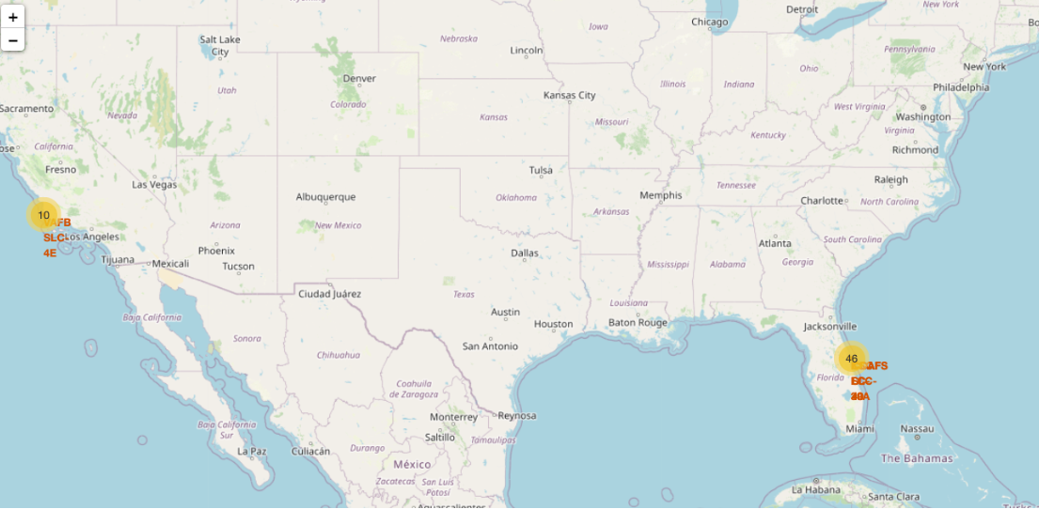
<Folium Map Screenshot 2>
GitHub link: https://github.com/hullamd/DSCapstone

Slide 37
<Folium Map Screenshot 3>
Replace <Folium map screenshot 3> title with an appropriate title
Explore the generated folium map and show the screenshot of a selected launch site to its proximities such as railway, highway, coastline, with distance calculated and displayed
Explain the important elements and findings on the screenshot

Slide 38

Section 4

Slide 39
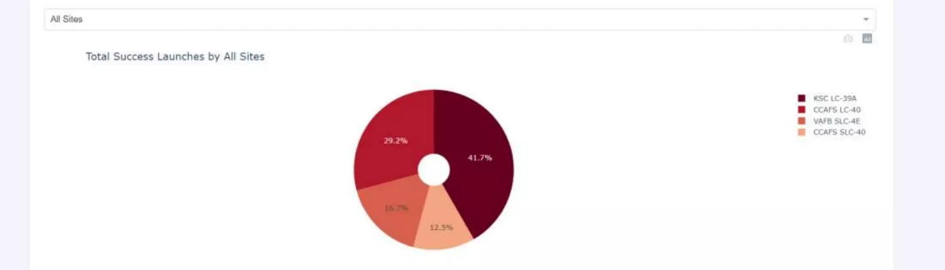
<Dashboard Screenshot 1>
KSC LC-39A has the highest success score
GitHub link: https://github.com/hullamd/DSCapstone

Slide 40
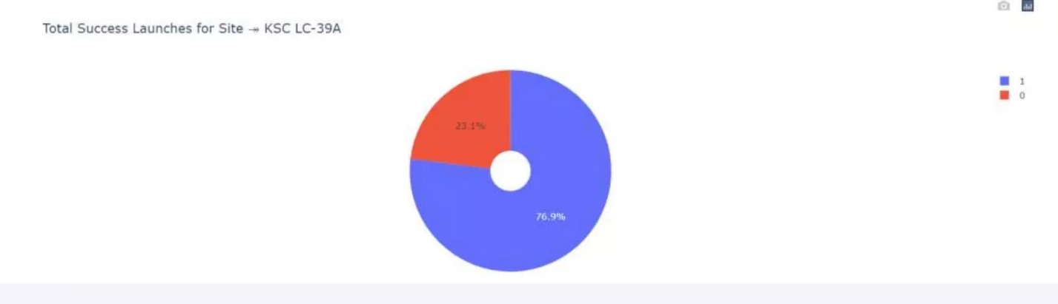
<Dashboard Screenshot 2>
KSC LC-39A has the highest score
GitHub link: https://github.com/hullamd/DSCapstone

Slide 41
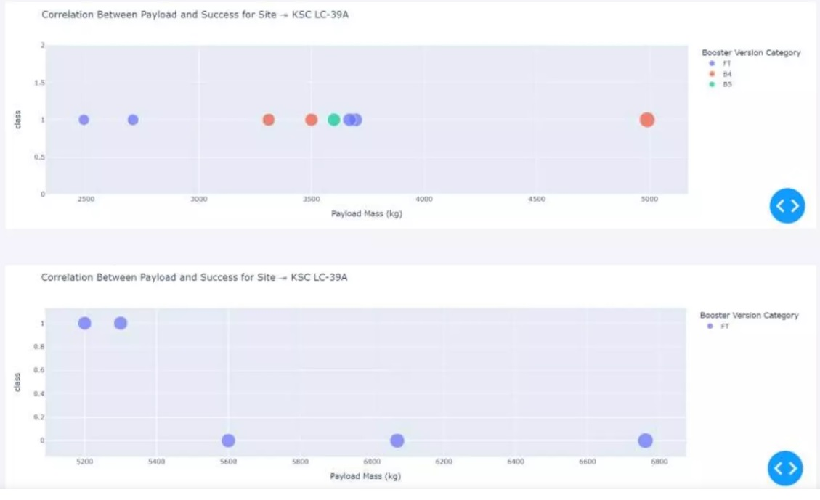
<Dashboard Screenshot 3>
GitHub link: https://github.com/hullamd/DSCapstone

Slide 42

Section 5

Slide 43
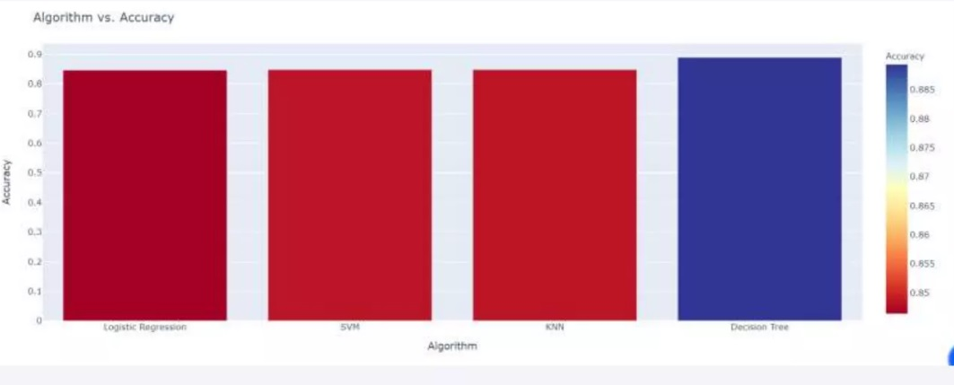
Classification Accuracy
Decision Tree has the highest accuracy
GitHub link: https://github.com/hullamd/DSCapstone

Slide 44
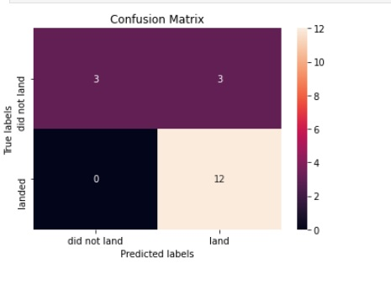
Confusion Matrix
Show the confusion matrix of the best performing model with an explanation
GitHub link: https://github.com/hullamd/DSCapstone

Slide 45
Conclusions
Orbits ES-L1, GEO, HEO and SSO has the hisghest success rates
Success rates for SpaceX lanches has been increasing with time
Decision Tree was the optimal model with accuracy of almost 0,89

Slide 46


